Slide 1
Practical Microservices
Code repo at: https://github.com/SuchSoftware/practical-microservices
If you haven’t pulled today, please do so to pick up a README change
Get Hands-on with Event Sourcing and CQRS

Slide 2
Goals
Understand the difference between “monolith” and “microservices”
Understand how software components communicate in an autonomous, service-based architecture
Take the first steps to modeling an autonomous service-based system
Implement an (simple) autonomous service-based system.

Slide 3
“Who is this guy?”
Ethan Garofolo
I help companies build microservice-based systems
Currently doing that as Head of Data Architecture at Berkadia Commercial Mortgage
If after this, you’re interested in working on this kind of a system (and wouldn’t mind moving to the Salt Lake City area), let’s talk!
@ethangarofolo on Twitter
https://tinyurl.com/microservices-mailing-list

Slide 4
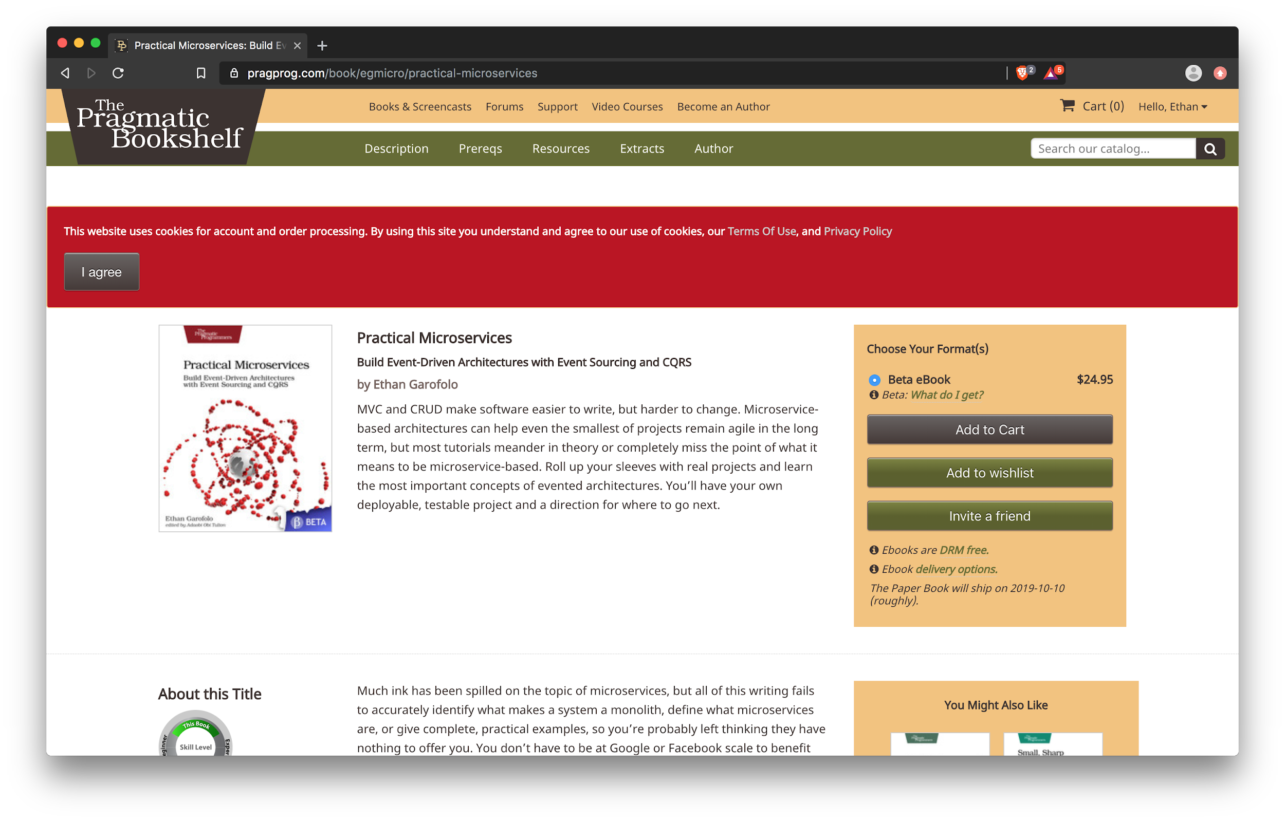
https://pragprog.com/book/egmicro/practical-microservices

Slide 5
Monolith
Vs
Microservice

Slide 6
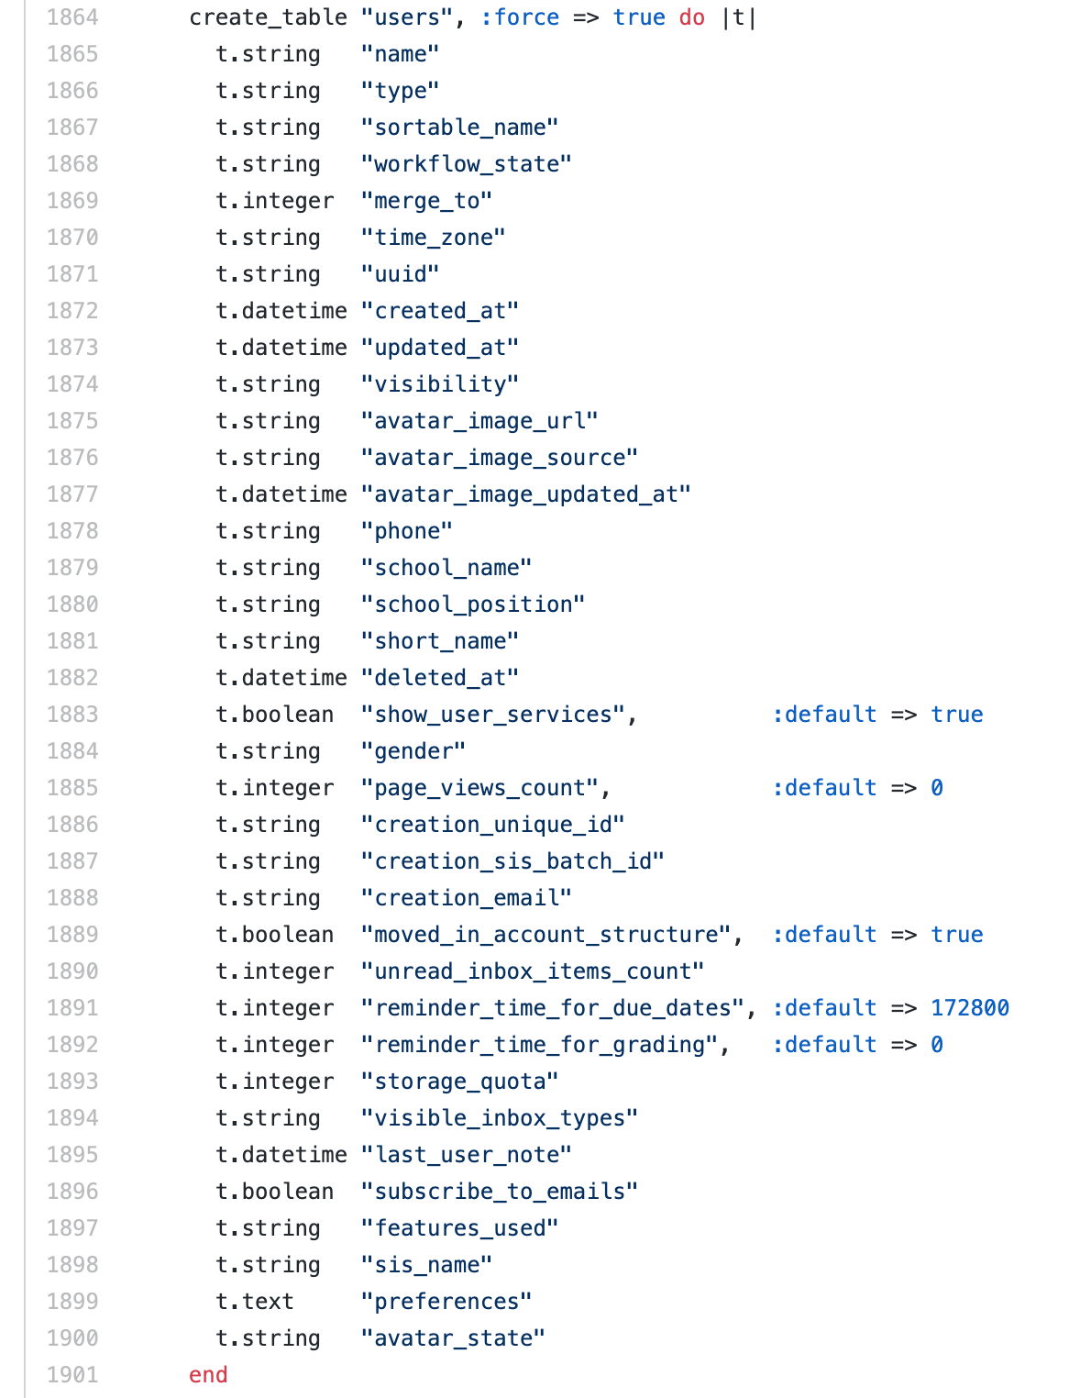
EXAMPLE OF MONOLITH
https://github.com/instructure/canvas-lms/blob/master/db/migrate/20101210192618_init_canvas_db.rb

Slide 7
EXAMPLE OF MONOLITH
What operation requires transactional consistency between these 2 data points?
t.integer "storage_quota" | t.string "time_zone"
https://github.com/instructure/canvas-lms/blob/master/db/migrate/20101210192618_init_canvas_db.rb

Slide 8
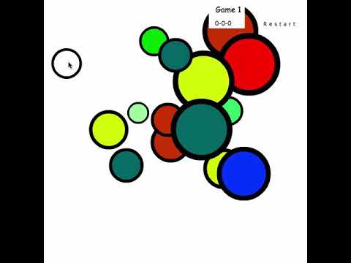
The User Model

Slide 9
“Extract microservices”

Slide 10
users
These lines are function calls
products

Slide 11
users
products

Slide 12
users
products

Slide 13

users
What are these lines now?
products

Slide 14
users
products

Slide 15

users
products

Slide 16
users
products

Slide 17
users
products

Slide 18

users
products

Slide 19
What defines a service?

Slide 20
Autonomy

Slide 21
Services are autonomous
No one asks them for anything (you ask databases for things, and that’s called querying)
They don’t ask anyone else for things (otherwise they’re dependent on those other things)
They are oblivious to the existence of other things

Slide 22
Services are autonomous
They aren’t web APIs
You wouldn’t find an Express server in a service
They aren’t databases
They don’t have GET APIs. Architecturally speaking, things with GET APIs are databases.
They aren’t database tables behind a web API

Slide 23
“Extract microservices”
Take Two

Slide 24








Slide 25
“JUST EXTRACT KITTENS FROM THIS SLIDE.” -- The Blogosphere

Slide 26
users
products

Slide 27
Application
DB

Slide 28
The Anticipation
Applications
Must Be
?
[
]
Unbearable

Slide 29
How do you get services to do things?

Slide 30
Messages
Sent
VideoPublished
VideoNamed
PublishVideo

Slide 31
Messages: commands and events
Sent
VideoPublished
VideoNamed
PublishVideo

Slide 32
Messages: commands and events
Sent
VideoPublished
VideoNamed
PublishVideo

Slide 33
Messages are organized into “streams”
video:command-84272a07
video-84272a07
email-e7431339
PublishVideo
VideoPublished
Sent
VideoNamed
See: http://docs.eventide-project.org/core-concepts/streams/

Slide 34
Stream boundaries are service boundaries
video:command-84272a07
video-84272a07
email-e7431339
PublishVideo
VideoPublished
Sent
VideoNamed
Video Publishing Service

Slide 35
Stream boundaries are service boundaries
video:command-84272a07
video-84272a07
email-e7431339
PublishVideo
VideoPublished
Sent
VideoNamed
Email Service

Slide 36
Services
Applications
Aggregators
Message Store
[
]
View data

Slide 37
Services
Applications
Aggregators
Message Store
[
]
View data

Slide 38
Some things will be trickier

Slide 39
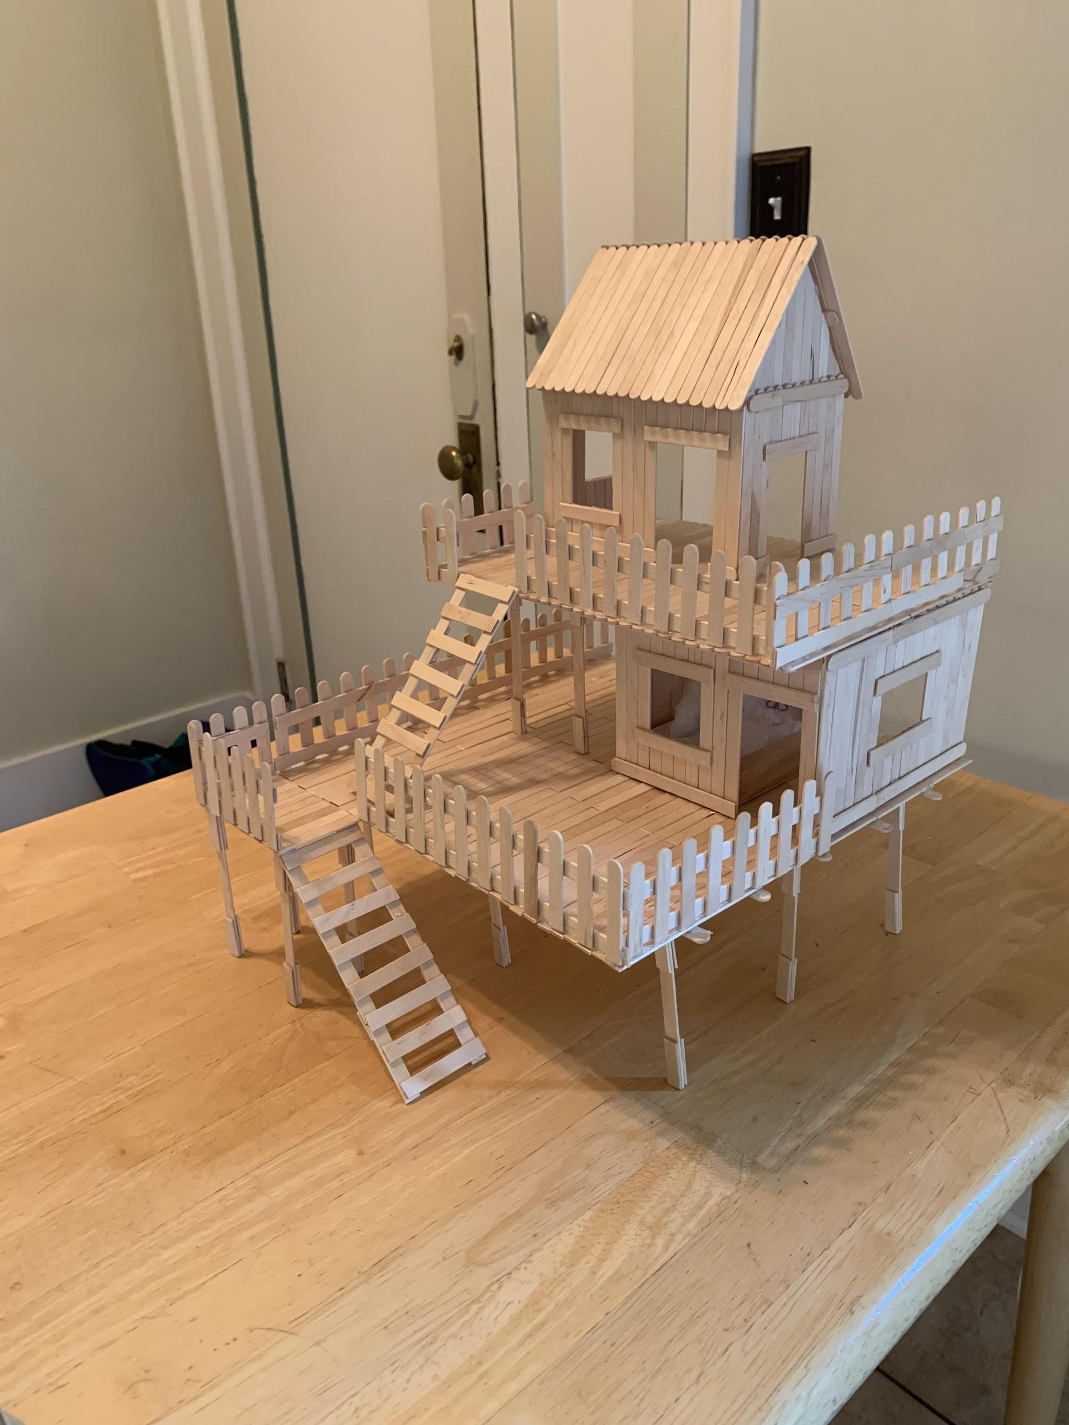

Which is harder to build?
Images courtesy: https://www.reddit.com/r/PetMice/comments/cv1e5i/popsicle_stick_mouse_house_just_finished_building/
And: https://en.wikipedia.org/wiki/File:Burj_Khalifa.jpg

Slide 40
Each has a purpose
We’re giving up transactions and immediate responses to get long-term velocity
UI will be trickier - The back end (components and aggregators) operate in batch mode, while the front end (browser clients and application servers) operate in user-interactive mode. How to bridge the gap?
Eventual consistency - It’s a blessing and a curse

Slide 41
Why “micro”services?

Slide 42
(smart|dumb) (pipes|endpoints)
Martin Fowler’s words
Smart Pipes
Dumb Endpoints
Dumb Pipes
Smart Endpoints
vs
https://martinfowler.com/articles/microservices.html#SmartEndpointsAndDumbPipes

Slide 43
(smart|dumb) (pipes|endpoints)
Martin Fowler’s words
Smart Pipes
Dumb Endpoints
Dumb Pipes
Smart Endpoints
vs
https://martinfowler.com/articles/microservices.html#SmartEndpointsAndDumbPipes

Slide 44
Introducing our dumb pipe

Slide 45

Message DB
https://github.com/message-db/message-db

Slide 46
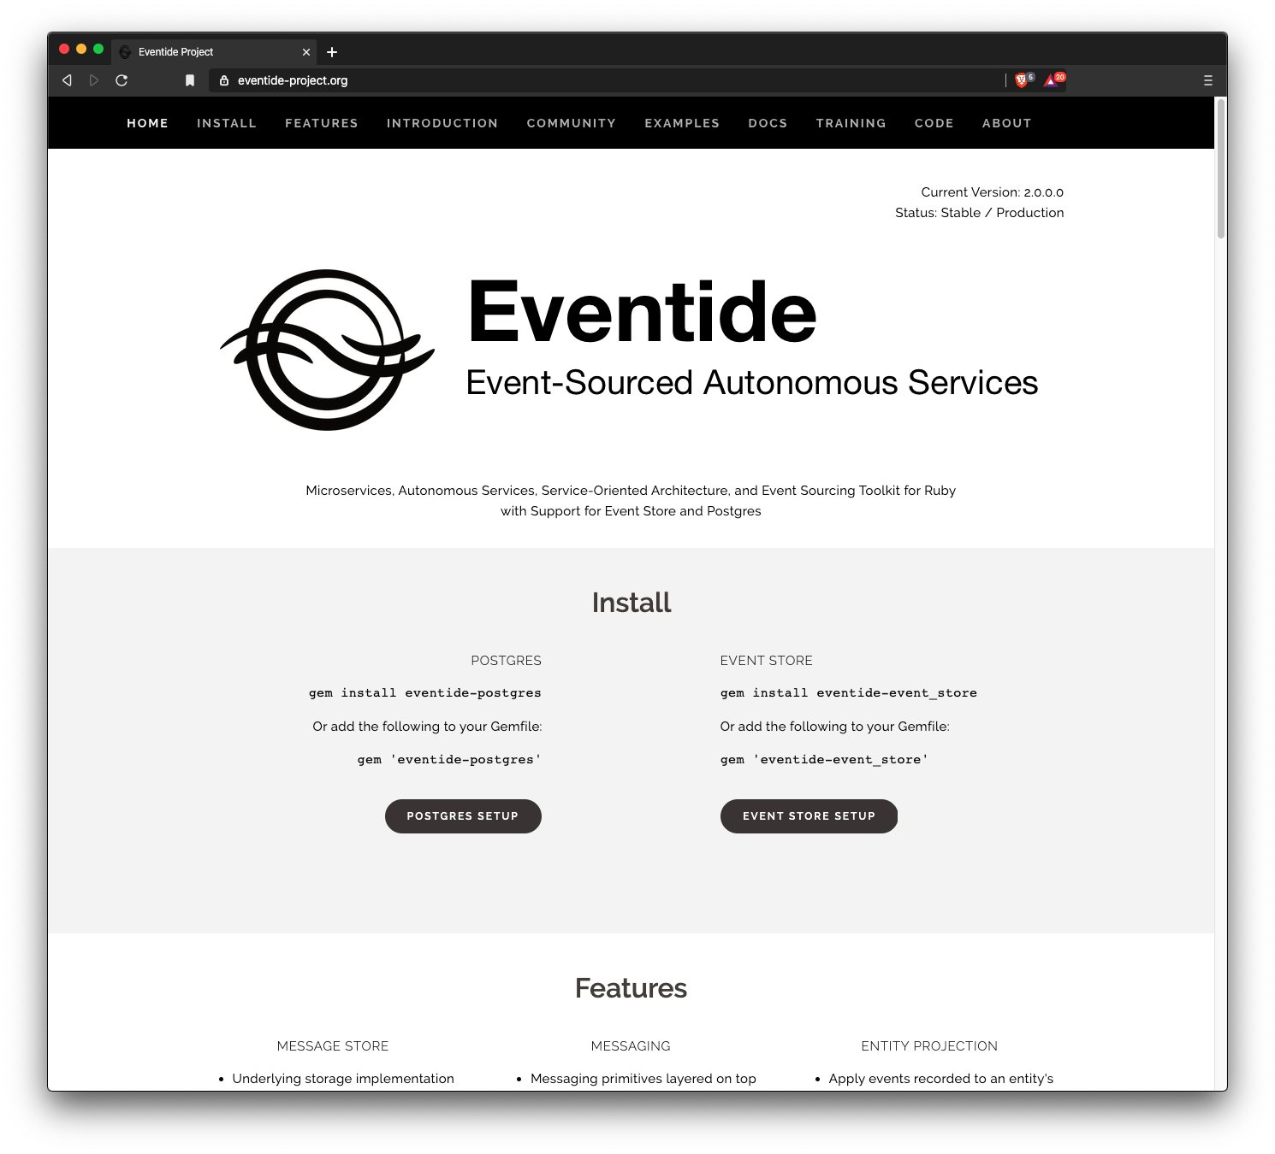
https://eventide-project.org/

Slide 47
Modeling the system

Slide 48
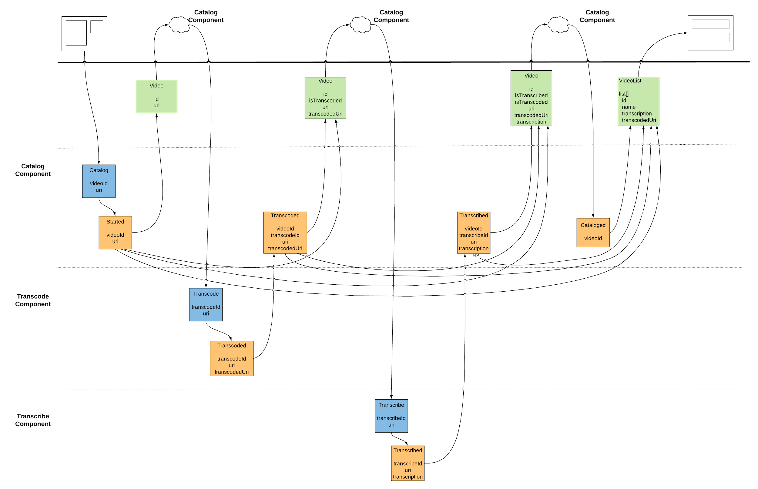
Where the real engineering work is done
https://eventmodeling.org/posts/what-is-event-modeling/

Slide 49
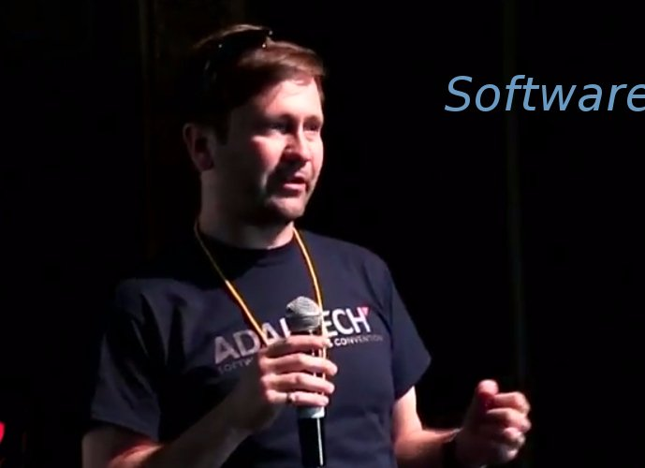
Where the real engineering work is done
Event Modeling is a system formalized by Adam Dymitruk*. @adymitruk on Twitter
* As someone with an oft-misprounounced last name, I won’t attempt Adam’s
https://eventmodeling.org/posts/what-is-event-modeling/

Slide 50
7 Steps (but we only do 6)
Brainstorming
Put them in temporal order
The Story Board
Identify inputs
Identify outputs
Draw boundaries (apply Conway’s Law)
https://eventmodeling.org/posts/what-is-event-modeling/

Slide 51
Step 1: Go forth and Brainstorm!
We’re building YooToob, an originally-named video site
Users upload videos direct to S3 - no event capture here
An API call is made to Start a cataloging process
Transcode the videos
Transcribe the videos
Declare them “cataloged” or ready to be viewed
Remember, events types are in the past tense and should not have the CRUD verbs in them
Don’t worry about putting them in order
Full result here, but don’t peek yet!

Slide 52
Step 2: Put them in temporal order
Could they occur out of order?
(View Step 2 at https://www.lucidchart.com/documents/view/d28db331-8271-4973-94f2-3ae8025ddf23/in4w5VgMj8hX)

Slide 53
Step 3: The Story Board
What are the pieces of the system that cause these events?
(View Step 3 at https://www.lucidchart.com/documents/view/d28db331-8271-4973-94f2-3ae8025ddf23)

Slide 54
Step 4: Identify Inputs
Events generally don’t occur without some sort of stimulus
What stimulus does our system have?
(View Step 4 at https://www.lucidchart.com/documents/view/d28db331-8271-4973-94f2-3ae8025ddf23)

Slide 55
Step 5: Identify Outputs
What occurs in response to the inputs?
(View Step 5 at https://www.lucidchart.com/documents/view/d28db331-8271-4973-94f2-3ae8025ddf23)

Slide 56
Step 6: Draw boundaries
What components do the messages organize into?
(View Steps 6a and 6b at https://www.lucidchart.com/documents/view/d28db331-8271-4973-94f2-3ae8025ddf23)

Slide 57
Let’s Build It!

Slide 58
Step 1: Write a message

Slide 59
Step 1: Write a message
git checkout step-01
exercises/01-write-a-message.js
Run it with “node exercises/01-write-a-message.js”
What happens when you run it?
BOOM!

Slide 60
Anatomy of a message
{
"id": "df671f4c-7864-45e8-834a-26e0f454f763",
"stream_name": "payment-027d383e-7896-4d39-90aa-f7a25e5da523",
"type": "PaymentReceived",
"position": 0,
"global_position": 3,
"data": "
{\"amount\": \"12.34\", \"paymentId\": \"027d383e-7896-4d39-90aa-f7a25e5da523\"}
",
"metadata": null,
"time": "2020-02-12 04:58:45.366911"
}

Slide 61
Step 1: Write a message
git checkout step-01
exercises/01-write-a-message.js
Run it with “node exercises/01-write-a-message.js”
What happens when you run it?
Fix the boom
Look at the database

Slide 62
Step 2: Exploring the Project Layout

Slide 63
Step 2: Exploring the Project Layout
git checkout step-02
src/index.js is the entry point
Lots of Dependency Injection, all wired together in src/config.js

Slide 64
Step 2: Exploring the Project Layout (src/index.js)
src/env.js
(pulls in env vars)
{
port: ‘3000’,
databaseUrl: ‘’,
// and friends
}

Slide 65
Step 2: Exploring the Project Layout (src/index.js)
src/env.js
(pulls in env vars)
src/config.js
(pulls in the sub-modules)
{
port: ‘3000’,
databaseUrl: ‘’,
// and friends
}
{
homePageApplication,
consumers: [],
// and friends
}

Slide 66
Step 2: Exploring the Project Layout (src/index.js)
src/env.js
(pulls in env vars)
src/config.js
(pulls in the sub-modules)
src/express/index.js
(configures express app)
{
port: ‘3000’,
databaseUrl: ‘’,
// and friends
}
{
homePageApplication,
consumers: [],
// and friends
}
expressApp

Slide 67
Step 2: Exploring the Project Layout (src/index.js)
src/env.js
(pulls in env vars)
src/config.js
(pulls in the sub-modules)
src/express/index.js
(configures express app)
{
port: ‘3000’,
databaseUrl: ‘’,
// and friends
}
{
homePageApplication,
consumers: [],
// and friends
}
expressApp
config.consumers.forEach(c => c.start())
expressApp.listen(env.port, signalAppStart)

Slide 68
Step 2: Exploring the Project Layout (src/index.js)
src/env.js
(pulls in env vars)
src/config.js
(pulls in the sub-modules)
src/express/index.js
(configures express app)
{
port: ‘3000’,
databaseUrl: ‘’,
// and friends
}
{
homePageApplication,
consumers: [],
// and friends
}
expressApp
config.consumers.forEach(c => c.start())
expressApp.listen(env.port, signalAppStart)

Slide 69
Step 2: Exploring the Project Layout (src/index.js)
src/env.js
(pulls in env vars)
src/config.js
(pulls in the sub-modules)
src/express/index.js
(configures express app)
{
port: ‘3000’,
databaseUrl: ‘’,
// and friends
}
{
homePageApplication,
consumers: [],
// and friends
}
expressApp
config.consumers.forEach(c => c.start())
expressApp.listen(env.port, signalAppStart)

Slide 70
Step 2: Exploring the Project Layout
git checkout step-02
src/index.js is the entry point
Lots of Dependency Injection (DI), all wired together in src/config.js
You won’t have to manage the DI. The steps will take care of that for you.

Slide 71
Step 3: Handling Our First Message (the Transcribe Command)

Slide 72
Services
Applications
Aggregators
Message Store
[
]
View data

Slide 73
transcribe Component
transcode
Component
catalog
Component
home-page
Application
video-list
Aggregator
Message Store
videos table

Slide 74
transcribe Component
transcode
Component
catalog
Component
home-page
Application
video-list
Aggregator
Message Store
videos table

Slide 75
Step 3: Handling our First Message (Transcribe)
git checkout step-03
exercises/02-handle-transcribe-command.js
Run it: node exercises/02-handle-transcribe-command.js

Slide 76
Step 4: Recycling Messages

Slide 77
Step 4: Recycling Messages
git checkout step-04
exercises/03-double-handle-transcribe-command.js
Run it
Inspect the Message Store
Uh-oh
What are we missing?

Slide 78
Step 5: projections

Slide 79
Services encounter the same message more than once
catalog-84272a07
Cataloged
catalog:command-84272a07
Catalog
Catalog
Component
id: ‘a0a50ac8’

Slide 80
Services encounter the same message more than once
?
catalog-84272a07
Cataloged
catalog:command-84272a07
Catalog
Catalog
Component
id: ‘a0a50ac8’
But it has already been cataloged
same id

Slide 81
Services encounter the same message more than once
?
handleCatalogIncorrectly (catalog) {
await doTheProcessing()
const cataloged = buildCatalogedEvent()
await write(
‘catalog-84272a07`,
Published
)
}
catalog-84272a07
Cataloged
video:command-84272a07
PublishVideo
Video
Publishing
Service

Slide 82
Services encounter the same message more than once
?
handleCatalogIncorrectly (catalog) {
await doTheProcessing()
const cataloged = buildCatalogedEvent()
await write(
‘catalog-84272a07`,
Published
)
}
catalog-84272a07
Cataloged
video:command-84272a07
PublishVideo
Video
Publishing
Service

Slide 83
Services encounter the same message more than once
?
handleCatalogIncorrectly (catalog) {
await doTheProcessing()
const cataloged = buildCatalogedEvent()
await write(
‘catalog-84272a07`,
Published
)
}
catalog-84272a07
Cataloged
video:command-84272a07
PublishVideo
Video
Publishing
Service
Cataloged

Slide 84
Services encounter the same message more than once
?
handleCatalog (catalog) {
const video = store.fetch(‘84272a07’)
if (video.cataloged) {
log(‘Already cataloged’, catalog.id)
return true
}
await doTheProcessing()
const cataloged = buildCatalogedEvent()
await write(
‘catalog-84272a07`,
Published
)
}
catalog-84272a07
Cataloged
video:command-84272a07
PublishVideo
Video
Publishing
Service

Slide 85
Services project streams into entities
catalog-84272a07
Cataloged
{
id: null,
cataloged: false
}

Slide 86
Services project streams into entities
catalog-84272a07
Cataloged
{
id: ‘84272a07’,
cataloged: true
}

Slide 87
Another projection example

Slide 88
Services project streams into entities
account-84272a07
{
id: ‘84272a07’,
balance: 0
}
Deposited
$5
Withdrawn
$3
Deposited
$40

Slide 89
Services project streams into entities
account-84272a07
{
id: ‘84272a07’,
balance: 5
}
Deposited
$5
Withdrawn
$3
Deposited
$40

Slide 90
Services project streams into entities
account-84272a07
{
id: ‘84272a07’,
balance: 2
}
Deposited
$5
Withdrawn
$3
Deposited
$40

Slide 91
Services project streams into entities
account-84272a07
{
id: ‘84272a07’,
balance: 42
}
Deposited
$5
Withdrawn
$3
Deposited
$40

Slide 92
Services encounter the same message more than once
?
handleCatalog (catalog) {
const video = store.fetch(‘84272a07’)
if (video.cataloged) {
log(‘Already cataloged’, catalog.id)
return true
}
await doTheProcessing()
const cataloged = buildCatalogedEvent()
await write(
`catalog-84272a07`,
Published
)
}
catalog-84272a07
VideoPublished
video:command-84272a07
{
id: ‘84272a07’,
cataloged: true
}
PublishVideo
Video
Publishing
Service

Slide 93
Services encounter the same message more than once
?
handleCatalog (catalog) {
const video = store.fetch(‘84272a07’)
if (video.cataloged) {
log(‘Already cataloged’, catalog.id)
return true
}
await doTheProcessing()
const cataloged = buildCatalogedEvent()
await write(
`catalog-84272a07`,
Published
)
}
catalog-84272a07
VideoPublished
video:command-84272a07
{
id: ‘84272a07’,
cataloged: true
}
PublishVideo
Video
Publishing
Service

Slide 94
Services encounter the same message more than once
?
handleCatalog (catalog) {
const video = store.fetch(‘84272a07’)
if (video.cataloged) {
log(‘Already cataloged’, catalog.id)
return true
}
await doTheProcessing()
const cataloged = buildCatalogedEvent()
await write(
`catalog-84272a07`,
Published
)
}
video-84272a07
VideoPublished
video:command-84272a07
{
id: ‘84272a07’,
cataloged: true
}
PublishVideo
Video
Publishing
Service

Slide 95
Step 5: Projections
git checkout step-05
exercises/04-projecting-the-transcription.js
Run it
Notice it isn’t transcribed
Open src/transcribe-component/projection.js
Add a property to the projection
The key is the type of event we care about (Transcribed)
The value is a function that takes the current state of the transcription and the actual event that we’re applying

Slide 96
Step 6: Making the Transcribe Handler Idempotent

Slide 97
Step 6: Making the Transcribe Handler Idempotent
git checkout step-06
exercises/03-double-handle-transcribe-command.js (again)
Make use of the projection in src/transcribe-component/index.js to make the Transcribed handler idempotent
Re-run the exercise, and notice that the recycled message is caught

Slide 98
Step 7: Subscribing to the Message Store

Slide 99
Step 7: Subscribing to the Message Store
git checkout step-07
exercises/05-write-transcribe-command.js
Look in the Message Store and see the command
Add the subscription code
Run the server
Look in the Message Store and see the resulting event

Slide 100
Step 8: Handling the Transcode Command

Slide 101
transcribe Component
transcode
Compnent
transcode
Component
catalog
Component
DONE
home-page
Application
video-list
Aggregator
Message Store
videos table

Slide 102
Step 8: Handling the Transcode Command
git checkout step-08
exercises/06-handle-transcode-command.js
Events from the transcode component go in the “transcode” category
Fill out projection in src/transcode-component/projection.js
Fill out handler in src/transcode-component/index.js
Run exercise
You should see a Transcoded event in the message store

Slide 103
Step 9: Orchestrating Components

Slide 104
transcribe Component
transcode
Component
catalog
Component
DONE
DONE
home-page
Application
video-list
Aggregator
Message Store
videos table

Slide 105
How does the catalog component get the other two to do their thing?
catalog-123
catalog component
Catalog
transcode component
transcribe component

Slide 106
How does the catalog component get the other two to do their thing?
catalog-123
catalog component
Started
Catalog
transcode component
transcribe component

Slide 107
Step 9: Starting a long-running process
git checkout step-09
exercises/07-handle-catalog-command.js
The projection in src/catalog-component/projection.js is filled out for you
Fill out the Catalog handler in src/catalog-component/index.js
3 steps: load entity, check idempotence, write event
Run exercise
You should see a Started event in the message store

Slide 108
Step 10: Handling Started

Slide 109
catalog-123
catalog component
Started
transcode component
transcribe component

Slide 110
catalog-123
catalog component
Started
Transcode
transcode-123
transcode component
transcribe component

Slide 111
catalog-123
How will we know if a transcode job came from the catalog component?
catalog component
Started
Transcode
transcode-123
transcode component
transcribe component

Slide 112
catalog-123
How will we know if a transcode job came from the catalog component?
catalog component
Started
Transcode
metadata: {
originStreamName: ‘catalog-123’
}
transcode-123
transcode component
transcribe component

Slide 113
Step 10: Handling Started
git checkout step-10
exercises/08-handle-started-event.js
We want to drive the process from our own events
Fill out Started handler in src/catalog-component/index.js
Catalog entities are in the “catalog” category
Write Transcode command to “transcode:command” category
Generate a UUID for the transcodeId for the command and write to “transcode:command-<new uuid>”
Run the exercise

Slide 114
Step 11: Handling Transcoded from transcode-component

Slide 115
catalog-123
catalog component
Started
transcode-123
Transcoded
transcode component
transcribe component

Slide 116
catalog-123
catalog component
Started
Transcoded
transcode-123
Transcoded
transcode component
transcribe component

Slide 117
Step 11: Handling Transcoded from transcode
git checkout step-11
exercises/09-handle-transcoded-event-caused-by-catalog.js
Fill out the handler returned from `createTranscodeEventHandlers` in `src/catalog-component/index.js`
Run the exercise and see that the Transcoded event is copied

Slide 118
Step 12: Handling Transcoded from Catalog-component

Slide 119
catalog-123
catalog component
How do we get transcibe to do a transcription?
Started
Transcoded
transcode-123
Transcoded
transcode component
transcribe component
transcribe-123

Slide 120
catalog-123
catalog component
How do we get transcibe to do a transcription?
Started
Transcoded
Transcribe
metadata: {
originStreamName: ‘catalog-123’
}
transcode-123
Transcoded
transcode component
transcribe component
transcribe-123

Slide 121
Step 12: Handling Transcoded from Catalog
git checkout step-12
exercises/10-handle-transcoded-event-in-catalog-stream.js
In `src/catalog-component/index.js`
Where do we add a handler for this Transcoded event?
What do we check for idempotence?
What stream do we write the Transcribe command to?
Nothing is scaffolded for this one

Slide 122
Step 13: Doing the Same Thing for Transcription

Slide 123
catalog-123
catalog component
Started
Transcoded
Transcribe
transcode-123
Transcoded
transcode component
transcribe component
transcribe-123

Slide 124
catalog-123
catalog component
Started
Transcoded
Transcribe
transcode-123
Transcoded
transcode component
transcribe component
transcribe-123
Transcribed

Slide 125
catalog-123
catalog component
Started
Transcoded
Transcribe
transcode-123
Transcoded
transcode component
transcribe component
transcribe-123
Transcribed

Slide 126
catalog-123
catalog component
Started
Transcoded
Transcribed
Transcribe
transcode-123
Transcoded
transcode component
transcribe component
transcribe-123
Transcribed

Slide 127
Step 13: Doing the Same Thing for Transcription
git checkout step-13
exercises/11-handle-transcribed-event-in-transcribe-stream.js
Handling the output from the transcribe component
In `src/catalog-component/index.js`
Where do we add a handler for this Transcribed event?
What do we check for idempotence?

Slide 128
catalog-123
catalog component
Started
Transcoded
Transcribed
transcode-123
Transcoded
transcode component
transcribe component
transcribe-123
Transcribed

Slide 129
catalog-123
catalog component
Started
Transcoded
Transcribed
transcode-123
Cataloged
Transcoded
transcode component
transcribe component
transcribe-123
Transcribed

Slide 130
Step 13: Doing the Same Thing for Transcription
Still on git step-13
exercises/12-handle-transcribed-event-in-catalog-stream.js
Handling our own Transcribed Event
Need to declare the video Cataloged
In `src/catalog-component/index.js`
Where do we add a handler for this Transcoded event?
What do we check for idempotence?
What stream do we write the Transcribe command to?

Slide 131
Step 13: Doing the Same Thing for Transcription
Wipe the databases (docker-compose rm -sf)
Fire up the databases (docker-compose up)
Start the server (npm start)
Run the exercise (node exercises/13-whole-process.js)
Inspect the database (WOOT!)

Slide 132
Step 14: Touring the application changes

Slide 133
transcribe Component
transcode
Component
catalog
Component
DONE
DONE
DONE
home-page
Application
video-list
Aggregator
Message Store
videos table

Slide 134
Step 14: Touring the application changes
No exercise
In src/home-application/index.js we added a bunch of request handlers
Notice uploadVideo (req, res) --- It writes a command
Various wiring was done in config.js
Database migration in migrations
Restart the server (npm start)
Navigate to http://localhost:3000
Upload a video!
Uh-oh, it hangs at the interstitial
That’s because we’re not aggregating anything

Slide 135
Step 15: Aggregating the results into View Data

Slide 136
Step 15: Aggregating the results into View Data
No exercise
We have linear logs of append-only events, but we want to show a list of videos

Slide 137
?
catalog-123
Started
Transcoded
Transcribed
Cataloged
123
catalog-abc
Started
Transcoded
Transcribed
Cataloged
abc
456
catalog-456
Started
Transcoded
Transcribed
Cataloged

Slide 138
transcribe Component
transcode
Component
catalog
Component
DONE
DONE
DONE
home-page
Application
video-list
Aggregator
Message Store
DONE
DONE
videos table

Slide 139
Step 15: Aggregating the results into View Data
No exercise
We have linear logs of append-only events, but we want to show a list of videos
An Aggregator is almost exactly like a component, only instead of writing messages, it updates View Data

Slide 140
transcribe Component
transcode
Component
catalog
Component
DONE
DONE
DONE
home-page
Application
video-list
Aggregator
DONE
Message Store
DONE
DONE
videos table

Slide 141
questions?

Slide 142
More info
BOOK! https://pragprog.com/book/egmicro/practical-microservices
https://tinyurl.com/microservices-mailing-list
Me on twitter: https://twitter.com/EthanGarofolo
Eventide Project: https://eventide-project.org/

Slide 143
